Slide 1


SEASONAL AND SPATIAL CHANGES IN LARVAL FISH ASSEMBLAGES ALONG THE DUTCH COAST, SOUTHERN NORTH SEA
Rafael PÉREZ-DOMÍNGUEZ.
Institute of Estuarine and Coastal Studies (IECS), Department of Biological Sciences, University of Hull, Hull, HU6 7RX, United Kingdom
Onno van Tongeren
Port of Rotterdam. Data-Analyse Ecologie, Vrij Nederlandstraat 57,
6826 AW Arnhem,The Netherlands
William Borst
Projectorganisatie Maasvlakte 2 (Port of Rotterdam)
Postbus 6622, 3002 AP Rotterdam, Rotterdam, The Netherlands
34th Annual Larval Fish Conference, Santa Fé, NM

Slide 2
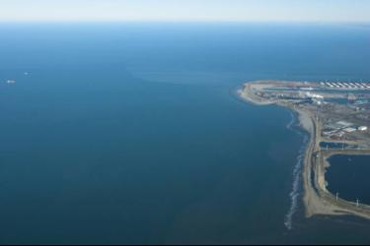
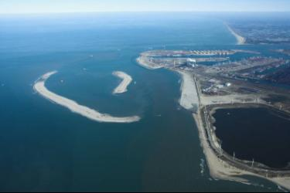
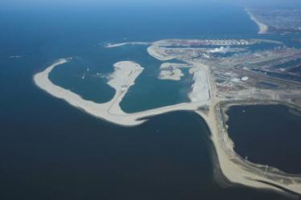
LARVAL ASSEMBLAGES: Dutch Coast
Maasvlakte 2 Land Reclamation
Total area ca 2,000 hectares , 13 km of quay walls & 12 km sea defences
Total capacity container throughput 17 million annually
Sand, 1st phase construction by 2013, 240 million m³, 365 million m³ (by 2033)
Trailing Suction Hopper Dredgers extract sand form offshore sites (7 to 20 km off the coast)
Navigation channel 10 nautical miles, and up to 20 meter deep
Start, Jan 2009
Oct. 2009
April 2010
34th Annual Larval Fish Conference, Santa Fé, NM

Slide 3
LARVAL ASSEMBLAGES: Dutch Coast
Impacts on the receiving marine ecology?
Water Framework Directive (EU WFD; 2000/60/EC)
Marine Strategy Framework Directive (EU MSFD; 2008/56/EC)
Ecosystem integrity assessment
could larval fish be a sensitive measure of ecological integrity and impacts?
Effects on larval assemblages from ...
disruptive pressure on spawning habitat /spawning stock biomass
direct effects on larval fish survival
indirect effects on survival -food availability, predation
34th Annual Larval Fish Conference, Santa Fé, NM
Notes:
Water Quality Act, US Congress, Pub.L. 100-4, 1987; EU law mandate to identify quality status of surface waters
Silt and total suspended solid plume as main impact

Slide 4
LARVAL ASSEMBLAGES: Dutch Coast
Ecosystem integrity assessment
Biological elements response -indicators
sensitivity to pressure (calibration)
reference conditions
accurate and robust indication
technically feasible
bound by time and budget constraints
easy interpretation by non-specialists
Reference conditions of larval fish assemblages (time & space)
Optimization of effort
34th Annual Larval Fish Conference, Santa Fé, NM
Notes:
Water Quality Act, US Congress, Pub.L. 100-4, 1987; EU law mandate to identify quality status of surface waters
Silt and total suspended solid plume as main impact

Slide 5
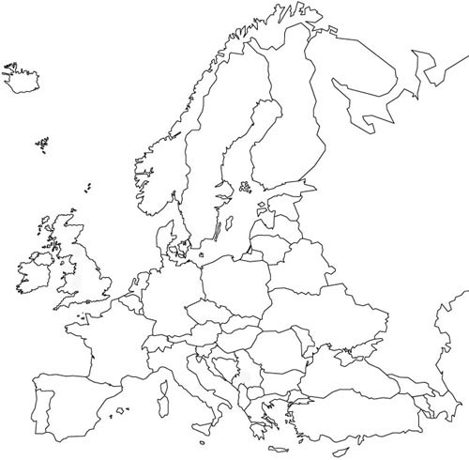
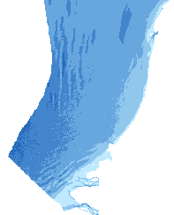
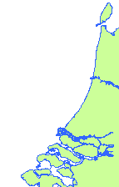

LARVAL ASSEMBLAGES: Dutch Coast
The study area
Depth (m)
Maasvlakte 2
Rotterdam
http://www.noordzeeatlas.nl/en/index.html
34th Annual Larval Fish Conference, Santa Fé, NM
Notes:
RELATIVELY SHELTERD AREA IN A REGIONAL RELATIVELY ENCLOSED MARGINAL SEA
Depth , water masses, currents, and seasonality

Slide 6
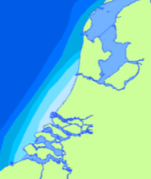
LARVAL ASSEMBLAGES: Dutch Coast
The study area
residual currents & water masses
http://www.noordzeeatlas.nl/en/index.html
"rest current" 1,0 to 1,5 cm/s
salinity
34th Annual Larval Fish Conference, Santa Fé, NM
Notes:
Physical and hydrodynamic background, water masses, currents, and seasonality
Fresh water river Rhine outflow (= coastal river along Dutch coast)
You show inserts of salinity which are influenced by the freshwater outflow of the Rhine, Meeuse
"rest current" 1,0 to 1,5 cm/s towards the Northeast along the Dutch coast

Slide 7
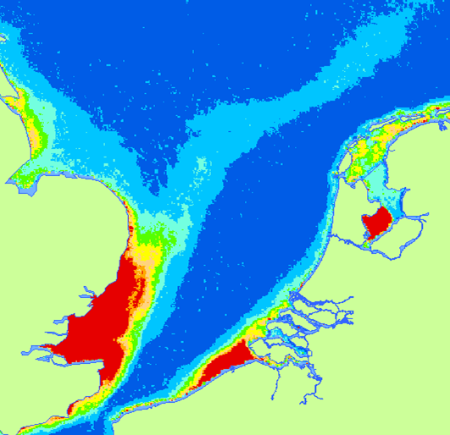
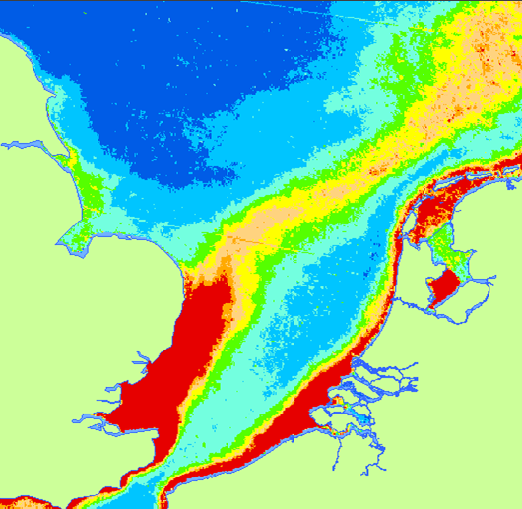
LARVAL ASSEMBLAGES: Dutch Coast
The study area:
Total Suspended Solids
Summer
Winter
Red = high
Blue = low
http://www.noordzeeatlas.nl/en/index.html
34th Annual Larval Fish Conference, Santa Fé, NM
Notes:
Physical and hydrodynamic background
TSM, depth (distance form shore) and seasonal effect

Slide 8
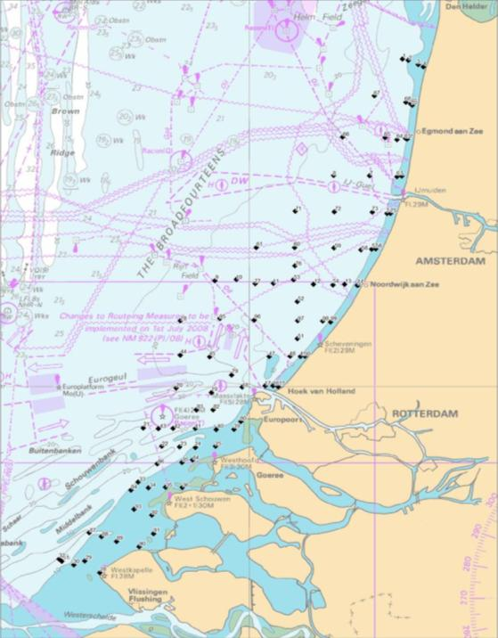
LARVAL ASSEMBLAGES: Dutch Coast
Methods Field:
Gear
Night time MIK trawls
2m Ø 1500µm body & 500µm codend
10-15’ tows & approx. 3200m⁻³ samples
Design
3 seasonal cruises
April, July & October
5m to 25m chart datum
100 stations
Water Quality
parameters
Maasvlakte 2
d
34th Annual Larval Fish Conference, Santa Fé, NM
Notes:
Slide 5 Methods (Field)
Times, gear….

Slide 9
LARVAL ASSEMBLAGES: Dutch Coast
MIK SAMPLE PARAMETERS
Larval density (ind./1000 m³) by species
Standard length
Stomach content analysis (n=108)
Multivariate
Datasets
ENVIRONMENTAL VARIABLES
Temperature
Salinity
Chlorophyll
% silt (bottom)
Total Suspended Matter
Station depth
Latitude
Cruise (degree day)
ASSEMBLAGES
34th Annual Larval Fish Conference, Santa Fé, NM

Slide 10
LARVAL ASSEMBLAGES: Dutch Coast
Results: Sampling effort & larval assemblage
100 stations
33 stations
99% of total
abundance
Cruise
APRIL
< 5% of samples
34th Annual Larval Fish Conference, Santa Fé, NM

Slide 11
LARVAL ASSEMBLAGES: Dutch Coast
Results: diversity by season
Species-Accumulation
estimation
K-dominance curves
100
16
90
12
80
Expected number of species
APRIL
Cumulative frequency
8
JULY
70
OCTOBER
60
4
50
0
0
1
0
10
20
30
40
log₁₀ rank
Samples
33 Samples
April July October
No. spp. 14 17 9
No. Unique spp. 10 4 1
34th Annual Larval Fish Conference, Santa Fé, NM

Slide 12
LARVAL ASSEMBLAGES: Dutch Coast
Assemblages:
Redundancy Analysis (RDA) Brodgar
October
Σ eigenvalues
0.34
1
3029
Degday
3025
3026
3077
3100
Strong seasonal effect
3013
3072
3101
3043
3093
3046
A minuta
3040
TSM
3079
3012
3039
3021
Flatfish dominated in April (local source of larvae?)
3037
3090
3080
1029
3007
3075
3006
3063
3059
3024
3062
3009
APRIL
3056
1030
18% variability; axis 2
2076
3060
1095
2056
3002
1032
2057
2030
2073
Silt%
1070
1047
1033
Peak diversity in Summer
0
1015
1054
2023
1036
2098
2007
1075
2063
2099
2097
2006
SAL
1087
1013
2062
1069
TEMP
2058
2024
2005
1016
1050
2053
1035
2054
1028
P platessa
2029
DEPTH
1051
P minutus
2034
2072
LAT
1065
1043
S solea
2068
1064
P flesus
E encrasicolus
1081
1046
Model: TEMP : Degday : TSM
79% explained variance
2040
1006
1061
S rostellatus
2084
1089
1020
2071
C lyra
1022
L limanda
S pilchardus
A laterna
1019
1005
2044
2039
1058
2060
1066
1068
C harengus
2081
2102
1072
Chlor
S sprattus
2002
2045
2019
1002
T trachurus
July
2066
1062
2087
2028
TSM relevant?
2103
2011
-1
63% variability; Axis 1
-1
0
1
34th Annual Larval Fish Conference, Santa Fé, NM
Notes:
Flatfish dominated in April (local spawning???), to more diverse (probably from distant sources) assemblage July, to few species at the end of the season
Forward selection found a 3-varaible model explains 79% of explained variance
Assemblages mean size by diagnostic species; differences suggest real structuring processes (transport and or mortality)

Slide 13
LARVAL ASSEMBLAGES: Dutch Coast
Assemblages: partial RDA
Covariates TEMP + Degday
Σ eigenvalues
0.09
1
Model: TSM : Chlor
21.2% explained variance, but very low predictive power
is TSM variability driving the assemblage or are they linked by a 3rd unknown variable?
1029
3029
1020
1032
1095
1028
3077
3025
1015
2076
3026
C harengus
1047
2057
2023
DEPTH
P platessa
1016
2030
2056
2034
1050
1033
1019
3040
3072
30% variability; axis 2
2006
1022
1069
2007
1068
2029
2063
1072
2062
2024
3013
1013
1030
2039
2058
1075
L imanda
3075
1051
3043
3060
2044
3059
2005
0
3039
2053
1070
3100
3037
1043
1061
3007
2073
SAL
2081
1081
1087
1054
2002
1035
2087
2071
2011
3062
3056
2072
2054
2028
2060
2040
1036
3101
C lyra
3093
TSM
1089
3063
3046
2045
3090
2102
3009
3006
B luteum
S pilchardus
1064
2068
2097
2103
1062
3012
2099
2098
3021
S sprattus
P minutus
3079
2066
1002
3002
1065
3080
T trachurus
E encrasicolus
2084
S rostellatus
2019
LAT
3024
S solea
Chlor
1046
Silt%
1066
1006
P flesus
… most explanatory power in the seasonal effect
-1
1058
1005
47% variability; axis 1
A laterna
-1
0
1
34th Annual Larval Fish Conference, Santa Fé, NM
Notes:
Why use two explanatory variables for the seasonal effects? Temp gradients within each month was very small. DEPTH, distance from the coast driving TSM
make clear here that the model TSM Chlor explains 53% of the residual variance (i.e. after removal of the seasonal effects. For example if Temp and Degday together explain 60% of the variance, only 53% of 40% =21.2% of the total variance is explained by TSM+Chlor, which means that ca. 13% of the variance is explained by TSM. The third unknown variable may be depth or salinity or a combination of both or some other variable related to depth or distance from the coast.

Slide 14
LARVAL ASSEMBLAGES: Dutch Coast
Species assemblages & abundance
A1 A2
April
October
P flesus
- 4.3 (ind/1000m³)
S rostellatus
0.5
A laterna
- 2.2
0.4
A minuta
L limanda
3.3 1.3
P minutus
2.8
C harengus
14.0 4.1
0
20
40
60
80
100
0
20
40
60
80
100
Similarity
Similarity
J1 J2 J3 J4
Assemblages:
Cluster analysis (Bray-Curtis similarity and SIMPROF test) Primer v6
T trachurus
- - 5.5 1.3
July
- - 7.4 -
C lyra
E encrasicolus
- - 7.6 1.1
S sprattus
3.9 - 10.3 0.7
P minutus
7.7 10.4 25.8 1.4
S pilchardus
- 6.5 - -
0
20
40
Similarity
60
80
100
34th Annual Larval Fish Conference, Santa Fé, NM
Notes:
Slide 8 Results Assemblages
Identity (SIMPER), seasonality and spatial distribution
Assemblages mean size by diagnostic species; differences suggest real structuring processes (transport and or mortality)

Slide 15
20
(a) April
60
A1 A2
100
P flesus
- 4.3 (ind/1000m³)
A laterna
- 2.2
L limanda
3.3 1.3
C harengus
14.0 4.1
0
20
40
60
80
100
Similarity
Rotterdam
Notes:
Slide 8 Results Assemblages
Identity (SIMPER), seasonality and spatial distribution
Assemblages mean size by diagnostic species; differences suggest real structuring processes (transport and or mortality)

Slide 16
(b) July
20
60
J1 J2 J3 J4
100
T trachurus
- - 5.5 1.3
C lyra
- - 7.4 -
E encrasicolus
- - 7.6 1.1
S sprattus
3.9 - 10.3 0.7
P minutus
7.7 10.4 25.8 1.4
Rotterdam
S pilchardus
- 6.5 - -
0
20
40
60
80
100
Similarity
Notes:
Slide 8 Results Assemblages
Identity (SIMPER), seasonality and spatial distribution
Assemblages mean size by diagnostic species; differences suggest real structuring processes (transport and or mortality)

Slide 17
(b) July
O1
(c) October
S rostellatus
0.5
A minuta
0.4
P minutus
2.8
0
20
40
60
80
100
Similarity
Rotterdam
Notes:
Slide 8 Results Assemblages
Identity (SIMPER), seasonality and spatial distribution
Assemblages mean size by diagnostic species; differences suggest real structuring processes (transport and or mortality)

Slide 18
LARVAL ASSEMBLAGES: Dutch Coast
Assemblages: spatial location
Mean length ± standard deviation (mm); (sample size)
April A1
April A2
April A1
April A2
Ijmuiden
Significant spatial segregation p<0.05 (PERMANOVA)
Uniform conditions,
Local source of flatfish larvae?
Rotterdam
34th Annual Larval Fish Conference, Santa Fé, NM
Notes:
Slide 8 Results Assemblages
Identity (SIMPER), seasonality and spatial distribution
Assemblages mean size by diagnostic species; differences suggest real structuring processes (transport and or mortality)

Slide 19
LARVAL ASSEMBLAGES: Dutch Coast
Assemblages: spatial location
Mean length ± standard deviation (mm); (sample size)
July J1
July J2
July J3
July J4
Diverse assemblage composition
Spatial segregation non significant but
… size differences significant (K-W & K-S tests)
Suggest segregation into cohorts & more heterogeneous conditions in summer ... transport? predation?
Rotterdam
... no assemblage differences in October!
34th Annual Larval Fish Conference, Santa Fé, NM
Notes:
Slide 8 Results Assemblages
Identity (SIMPER), seasonality and spatial distribution
Assemblages mean size by diagnostic species; differences suggest real structuring processes (transport and or mortality)

Slide 20
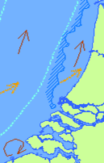
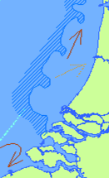
LARVAL ASSEMBLAGES: Dutch Coast
Conclusions (1)
sprat
Σ species
herring
Flatfish
sprat
sardine
sand goby
herring
Flatfish
sand goby
Flatfish
summer
spring
autumn
34th Annual Larval Fish Conference, Santa Fé, NM
Notes:
P minutus in summer when more heterogeneous conditions develop

Slide 21
LARVAL ASSEMBLAGES: Dutch Coast
Conclusions (2) and future research:
Main predictive variables Season and Temperature. Seasonal spawning.
TSM and Chlorophyll may have structuring roles but with very low predictive power
species diversity and seasonality best chances for a predictive model
Questions to answer
Can we derive a reference condition?
How to improve the models, more sampling or better designs?
Future work
are the models good enough? Sensitivity analysis
can we predict, logistic and multinomial logistic regression analysis -probabilities
are larval fish suitable for biomonitoring and impact assessment?
34th Annual Larval Fish Conference, Santa Fé, NM

Slide 22
LARVAL ASSEMBLAGES: Dutch Coast
Title:
34th Annual Larval Fish Conference, Santa Fé, NM
Notes:
Slide 8 Results Assemblages
Identity (SIMPER), seasonality and spatial distribution
Assemblages mean size by diagnostic species; differences suggest real structuring processes (transport and or mortality)

Slide 23
LARVAL ASSEMBLAGES: Dutch Coast
April 100 samples
April 33 samples
Σ eigenvalues
0.34
Σ eigenvalues
0.18
Model: TSM-LAT-TEMP
(Σ eigenvalues=0.13)
Model: TSM - SILT%
(Σ eigenvalues=0.18)
34th Annual Larval Fish Conference, Santa Fé, NM
Notes:
Slide 8 Results Assemblages
Identity (SIMPER), seasonality and spatial distribution
Assemblages mean size by diagnostic species; differences suggest real structuring processes (transport and or mortality)

Slide 24
LARVAL ASSEMBLAGES: Dutch Coast
July
October
Σ eigenvalues
0.31
Σ eigenvalues
0.28
Model: TSM (Σ eigenvalues=0.13)
34th Annual Larval Fish Conference, Santa Fé, NM
Notes:
Slide 8 Results Assemblages
Identity (SIMPER), seasonality and spatial distribution
Assemblages mean size by diagnostic species; differences suggest real structuring processes (transport and or mortality)

