Slide 1

SEASONAL AND SPATIAL CHANGES OF LATE LARVAE AND JUVENILE FLATFISHES ALONG THE DUTCH COAST, SOUTHERN NORTH SEA
Rafael PÉREZ-DOMÍNGUEZ.
Institute of Estuarine and Coastal Studies (IECS), Department of Biological Sciences, University of Hull, Hull, HU6 7RX, United Kingdom
Onno van Tongeren
Port of Rotterdam. Data-Analyse Ecologie, Vrij Nederlandstraat 57,
6826 AW Arnhem,The Netherlands
William Borst
Projectorganisatie Maasvlakte 2 (Port of Rotterdam)
Postbus 6622, 3002 AP Rotterdam, Rotterdam, The Netherlands
8th Flatfish symposium, IJmuiden

Slide 2

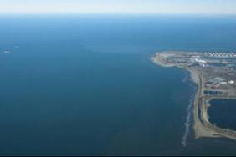
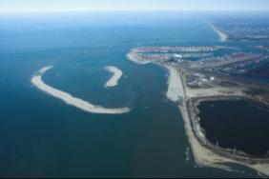
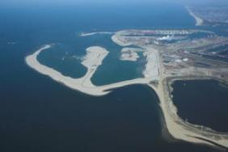
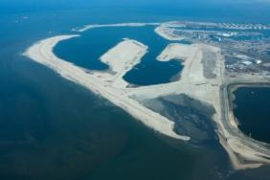
FLATFISH ASSEMBLAGES: Dutch Coast
Maasvlakte 2 Land Reclamation
Total area ca 2,000 hectares , 13 km of quay walls & 12 km sea defences
Sand, 1st phase construction by 2013, 240 million m³, 365 million m³ (by 2033)
Trailing Suction Hopper Dredgers extract sand form offshore sites (7 to 20 km off the coast)
Start, Jan 2009
Oct. 2009
April 2010
April 2011
Notes:
Martin Scholten; Institute involved in the baseline ecological studies for the development;
Silt and total suspended solid plume as main impact

Slide 3
FLATFISH ASSEMBLAGES: Dutch Coast
Impacts on the receiving marine ecology?
Water Framework Directive (EU WFD; 2000/60/EC)
Marine Strategy Framework Directive (EU MSFD; 2008/56/EC)
Ecosystem integrity assessment
Effects on (flat)fish assemblages from ...
disruptive pressure on habitat /spawning stock biomass
direct effects on fish survival
indirect effects on survival
-food availability, predation, energy budgets
could fish be a sensitive measure of ecological integrity and impacts?
Notes:
Water Quality Act, US Congress, Pub.L. 100-4, 1987; EU law mandate to identify quality status of surface waters

Slide 4

FLATFISH ASSEMBLAGES: Dutch Coast
Ecosystem integrity assessment
Water bodies in Europe: Integrative Systems to assess Ecological status and Recovery; University of Duisburg-Essen
Biological elements response/ indicators
sensitivity to human pressure (calibration)
accurate and robust indication
reference conditions
technically feasible
bound by time and budget constraints
easy interpretation by non-specialists
Notes:
Water Quality Act, US Congress, Pub.L. 100-4, 1987; EU law mandate to identify quality status of surface waters
Silt and total suspended solid plume as main impact
Larval supply, a proxy of reproduction, important ecosystem function

Slide 5
FLATFISH ASSEMBLAGES: Dutch Coast
Objectives
Modelling of fish assemblages for use in defining reference conditions
Functional linkage between larval supply and flatfish habitat

Slide 6
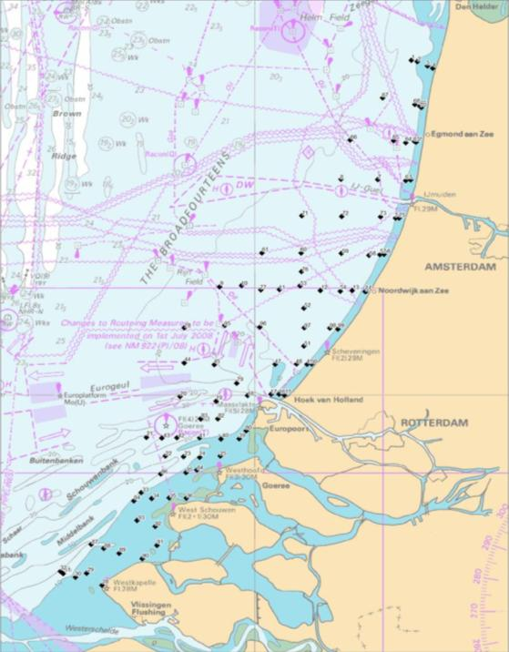
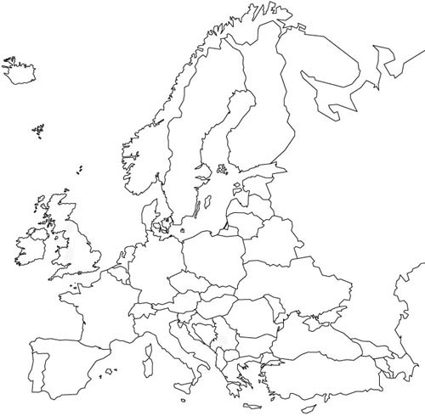
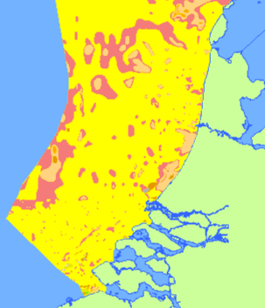
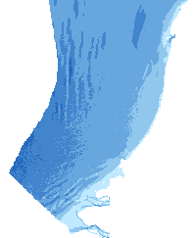
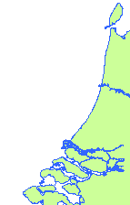

FLATFISH ASSEMBLAGES: Dutch Coast
Methods Field:
Design
100 stations & 3 seasonal cruises
April, July & October 2007,
5m to 25m chart datum, stratified &
fully randomized sampling sequence
The study area:
Sediment & Bathymetry
IJmuiden
Depth (m)
IJmuiden
Maasvlakte 2
Rotterdam
http://www.noordzeeatlas.nl/en/index.html
Notes:
Slide 5 Methods (Field)
Times, gear…. 160x30km in size

Slide 7
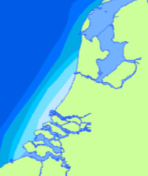
FLATFISH ASSEMBLAGES: Dutch Coast
The study area
residual currents & water masses
http://www.noordzeeatlas.nl/en/index.html
"rest current" 1,0 to 1,5 cm/s
salinity
Notes:
Physical and hydrodynamic background of the area, water masses, currents, and seasonality
Fresh water river Rhine outflow (= coastal river along Dutch coast)
inserts of salinity which are influenced by the freshwater outflow of the Rhine, Meeuse
"rest current" 1,0 to 1,5 cm/s towards the Northeast along the Dutch coast
Stratification results of water massess moving in different directions on the vertical gradient

Slide 8
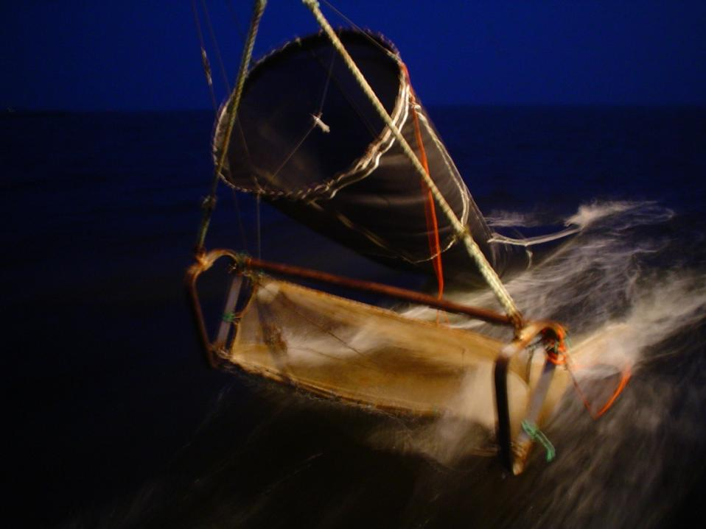
FLATFISH ASSEMBLAGES: Dutch Coast
Methods Field:
Gear
-MIK trawls
2m Ø 1500µm body & 500µm codend
5m above bottom
2 knots, approx. 3200m⁻³ samples
-Beam trawl
2m wide; 19mm & 9mm approx. 2500m⁻² samples
Water Quality
parameters
Notes:
Slide 5 Methods (Field), stratified, 3 depth strata, lat gradient, & tidal phase
Times, gear…. MIK survey design target late larva… 5 m off the bottom, relative large mesh….

Slide 9
FLATFISH ASSEMBLAGES: Dutch Coast
Beam Trawl survey (Demersal )
Juvenile/adult density (ind./1000 m²) Species ID, Standard length & Weight (Fulton K)
MIK survey (Pelagic)
Juvenile & Larval density (ind./1000 m³) Species ID, Standard length
Stomach content
Size class analysis
0+, 1 and 2+ flatfishes
Multivariate
Datasets
ENVIRONMENTAL VARIABLES
Ordination
Cluster analysis
Temperature
Salinity
Chlorophyll
% silt (bottom)
Total Suspended Matter
Station depth
Latitude
Cruise (degree day)
PELAGIC & DEMERSAL
Flatfish ASSEMBLAGES
Notes:
We used only species making up more than 95% of the abundance, and log-transform the abundance and some EXPLANATORY variables data as needed before analysis

Slide 10
LARVAL ASSEMBLAGES: Dutch Coast
Assemblages:
Redundancy Analysis (RDA)
Σ eigenvalues
0.34
October
1
3029
Degday
3025
3026
3077
3100
Strong seasonal effect
3013
3072
3101
3043
3093
3046
A minuta
3040
TSM
3079
3012
3039
3021
3037
3090
3080
1029
3007
Flatfish dominated in April
3075
3006
3063
3059
3024
3062
3009
April
3056
1030
18% variability; axis 2
2076
3060
1095
2056
3002
1032
Peak diversity in Summer
2057
2030
2073
Silt%
1070
1047
1033
0
1015
1054
2023
1036
2098
2007
1075
2063
2099
2097
2006
SAL
1087
1013
2062
1069
TEMP
2058
2024
2005
1016
1050
2053
1035
2054
1028
P platessa
2029
DEPTH
1051
P minutus
2034
2072
LAT
1065
1043
S solea
2068
1064
P flesus
Model: TEMP : Degday : TSM
79% explained variance
E encrasicolus
1081
1046
2040
1006
1061
2084
1089
1020
2071
C lyra
1022
L limanda
S pilchardus
A laterna
1019
1005
2044
2039
1058
2060
1066
1068
C harengus
2081
2102
1072
Chlor
S sprattus
2002
2045
2019
1002
T trachurus
July
2066
1062
2087
2028
TSM relevant?
2103
2011
-1
63% variability; Axis 1
-1
0
1
Notes:
Response variables & explanatory variables vectors; only a subsample 1/3rd of all 100 stations
Flatfish dominated in April (local spawning???), to more diverse (probably from distant sources) assemblage July, to few species at the end of the season
Forward selection found a 3-varaible model explains 79% of explained variance
Assemblages mean size by diagnostic species; differences suggest real structuring processes (transport and or mortality)

Slide 11
LARVAL ASSEMBLAGES: Dutch Coast
Assemblages: partial RDA
Covariates TEMP + Degday
Σ eigenvalues
0.09
1
Model: TSM : Chlor
21.2% explained variance, but very low predictive power
is TSM driving the assemblage structure or are they linked by a 3rd unknown variable?
1029
3029
1020
1032
1095
1028
3077
3025
1015
2076
3026
C harengus
1047
2057
2023
DEPTH
P platessa
1016
2030
2056
2034
1050
1033
1019
3040
3072
30% variability; axis 2
2006
1022
1069
2007
1068
2029
2063
1072
2062
2024
3013
1013
1030
2039
2058
1075
L imanda
3075
1051
3043
3060
2044
3059
2005
0
3039
2053
1070
3100
3037
1043
1061
3007
2073
SAL
2081
1081
1087
1054
2002
1035
2087
2071
2011
3062
3056
2072
2054
2028
2060
2040
1036
3101
C lyra
3093
TSM
1089
3063
3046
2045
3090
2102
3009
3006
B luteum
S pilchardus
1064
2068
2097
2103
1062
3012
2099
2098
3021
S sprattus
P minutus
3079
2066
1002
T trachurus
3002
1065
3080
E encrasicolus
2084
2019
LAT
3024
S solea
Chlor
1046
Silt%
1066
1006
… most explanatory power in the seasonal effect
P flesus
-1
1058
1005
47% variability; axis 1
A laterna
-1
0
1
Notes:
Why use two explanatory variables for the seasonal effects? Temp gradients within each month was very small. DEPTH, distance from the coast driving TSM
make clear here that the model TSM Chlor explains 53% of the residual variance (i.e. after removal of the seasonal effects. For example if Temp and Degday together explain 60% of the variance, only 53% of 40% =21.2% of the total variance is explained by TSM+Chlor, which means that ca. 13% of the variance is explained by TSM. The third unknown variable may be depth or salinity or a combination of both or some other variable related to depth or distance from the coast.

Slide 12
LARVAL ASSEMBLAGES: Dutch Coast
Assemblages:
Cluster analysis (Bray-Curtis similarity and SIMPROF test) & SIMPER (PRIMER v6)
April
A1 A2
Significant spatial segregation p<0.05 (PERMANOVA)
No effect
P flesus
- 4.3 (ind/1000m³)
A laterna
- 2.2
3.3 1.3
April A1
July J1
L limanda
April A2
14.0 4.1
July J2
C harengus
July J3
Solea solea, Pleuronectes platessa, Microchirus variegatus
July J4
July
J1 J2 J3 J4
T trachurus
- - 5.5 1.3
Rotterdam
- - 7.4 -
Rotterdam
C lyra
E encrasicolus
- - 7.6 1.1
S sprattus
3.9 - 10.3 0.7
P minutus
7.7 10.4 25.8 1.4
S pilchardus
- 6.5 - -
No assemblage differences in October
Arnoglossus laterna, Buglossidium luteum, Psetta maxima
Notes:
Slide 8 Results Assemblages, no differences in mean size: No size differences, Uniform conditions?
SIMPROF - (similarity profile) routine, which tests for evidence of structure in an a priori unstructured set of samples. In combination with clustering
SIMPER identifies the species primarily providing the discrimination between two observed sample clusters (Diagnostic species)
Identity (SIMPER), seasonality and spatial distribution
Assemblages mean size by diagnostic species; differences suggest real structuring processes (transport and or mortality)

Slide 13
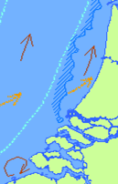
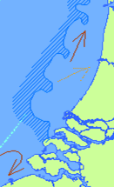
LARVAL ASSEMBLAGES: Dutch Coast
Conclusions (1)
sprat
Σ species
herring
Flatfish
sand goby
sprat
sardine
sand goby
herring
Flatfish
Flatfish
summer
spring
autumn
Notes:
P minutus in summer, when more heterogeneous conditions develop

Slide 14
Juvenile flatfish assemblages: Dutch Coast
Assemblages:
Redundancy Analysis (RDA)
Σ eigenvalues
0.29
1
1 A_laterna
1 B_luteum
44O
77O
45O
43O
78O
90O
47O
52O
79O
Month instead of Degday
42O
95O
53O
76O
October
46O
7O
11O
20O
61O
71O
65O
8O
9O
64O
1O
60O
48O
10O
58O
66O
72O
86O
82O
67O
59O
0+ A_laterna
Larvae included as explanatory variables
21O
68O
19O
97O
87O
63O
49O
DEPTH
96O
18O
88O
17O
12O
83O
51O
SAL
1 P_platessa
1 S_solea
32O
62O
54O
22O
98O
93O
73O
57O
33O
55O
0+ L_limanda
94O
81O
41O
23O
13O
31O
89O
70O
69O
28O
40O
29O
0+B_luteum
2O
74O
99O
80O
50O
15O
92O
35O
39O
91O
75O
30O
24O
2 B_luteum
3O
34O
16O
L_Limanda
56O
36O
85O
52A
1 L_limanda
52J
25O
6O
84O
44J
95J
L_Microchirus
20J
9A
79J
95A
76A
78J
71J
77J
47J
5O
L_Pleuronectes
Model: Month : DEPTH: SAL
85% explained variance
axis 2
2 L_limanda
79A
9J
43J
19J
82J
4O
42J
77A
7A
61J
LAT
45J
46J
0
10A
72A
20A
10J
76J
Silt%
44A
47A
97J
11A
58A
96J
72J
32J
66A
60J
71A
61A
8J
8A
53A
54A
21A
63A
78A
53J
1A
L_Platichthys
2 P_platessa
96A
65A
64A
86J
87J
59A
43A
66J
11J
60A
90A
21J
83J
90J
45A
46A
42A
86A
87A
67A
97A
23J
32A
54J
48J
12A
48A
67J
65J
L_Solea
13A
59J
51J
68A
18J
81J
64J
7J
22J
L_Arnoglossus
82A
1J
31J
22A
19A
58J
63J
Chlor
49A
23A
57A
18A
88A
49J
83A
51A
17A
62A
1 P_flesus
17J
Larva do not explain structure of 0+ flatfish
94A
12J
April
94J
73A
93A
2 S_solea
July
2 A_laterna
55A
56A
33J
93J
31A
98A
24J
80J
88J
70A
35J
69A
41J
40J
33A
92A
5A
73J
13J
24A
74A
36J
91J
99J
34J
28J
89A
92J
30J
85J
29A
68J
81A
28A
6A
75A
50A
39J
29J
0+ P_platessa
2A
41A
91A
30A
35A
62J
84J
98J
55J
40A
36A
85A
84A
89J
3A
16A
80A
0+ S_solea
34A
99A
15A
2J
25J
16J
57J
Juvenile abundance probably not controlled by larval supply
April
39A
4A
6J
15J
50J
74J
July
25A
70J
5J
69J
75J
3J
4J
56J
Size class differences related to differential temporal and spatial use of the area
-1
-1
0
1
axis 1
Notes:
Slide 8 Results Assemblages
seasonality and spatial distribution along the depth gradient
Assemblages segregate by age; differences suggest real structuring processes (transport and or mortality)
Larvae do not explain structure, because it does not have a role and 0+ is solely responding to nursery factors –after settlement mechanism- or the effect was outside the survey domain??????

Slide 15
Juvenile flatfish assemblages: Dutch Coast
Title: Seasonal & Spatial variability
Solea solea
Pleuronectes platessa
Arnoglossus laterna
<-1
0
>1
Limanda limanda
Buglossidium luteum
April
July
Oct.
Notes:
Abundance data, residual analysis to show differences

Slide 16
Flatfish ASSEMBLAGES: Dutch Coast
Conclusions (2):
Larval assemblages
Flatfish larvae dominate in the Spring
Main predictive variables Season and Temperature. Seasonal spawning.
TSM and Chlorophyll may have structuring roles but with very low predictive power
Species diversity and seasonality best chances for a predictive model
Juvenile flatfishes
Assemblages segregate by size groups reflecting seasonal and spatial variability in usage of the nursery
Main predictive variables Month, Depth and Salinity. Habitat characteristics
Larvae abundance (supply of recruits) does not explain abundance of juvenile flatfishes, flatfish assemblages probably controlled by postsettlement mechanisms… or is it sampling bias?
Notes:
Assemblages segregate by age; differences suggest real structuring processes (transport and or mortality)
Larvae do not explain structure, because it does not have a role and 0+ is solely responding to nursery factors –after settlement mechanism- or the effect was outside the survey domain

Slide 17
Flatfish ASSEMBLAGES: Dutch Coast
Questions to answer & Future work
Can we derive a reference condition?
Need to account for interanual variability in recruitment. Longer datasets
How to improve the models, more sampling or better designs?
are the models good enough? Sensitivity analysis
can we predict, logistic and multinomial logistic regression analysis -probabilities
are fish (all stages) suitable for biomonitoring and impact assessment?

Slide 18
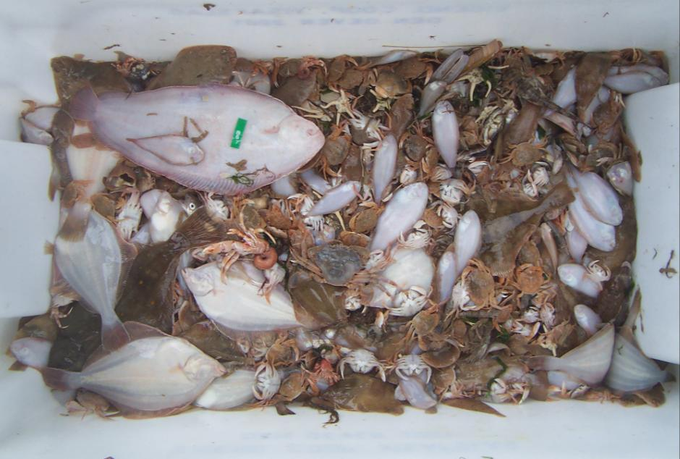
Flatfish ASSEMBLAGES: Dutch Coast
8th Flatfish symposium, IJmuiden
Thank you!

